Slide 1
Random Variables

Slide 2
Random Variable
A random variable x takes on a defined set of values with different probabilities.
For example, if you roll a die, the outcome is random (not fixed) and there are 6 possible outcomes, each of which occur with probability one-sixth.
Random variable
Associates A numerical value to each outcome of a particular experiment

Slide 3
Frequently, when an experiment is performed, we are interested
mainly in some function of the outcome as opposed to the actual outcome itself.
For instance, in tossing dice, we are often interested in the sum of the
two dice and are not really concerned about the separate values of each die.

Slide 4
That is, we may be interested in knowing
that the sum is 7 and may not be concerned over whether the actual outcome was
(1, 6), (2, 5), (3, 4), (4, 3), (5, 2), or (6, 1).

Slide 5
Also, in flipping a coin, we may be interested
in the total number of heads that occur and not care at all about the actual head–tail sequence that results.

Slide 6
These quantities of interest, or, more formally, these real-valued functions defined on the sample space, are known as random variables.
Because the value of a random variable is determined by the outcome of the experiment, we may assign probabilities to the possible values of the random variable.

Slide 7
Suppose that our experiment consists of tossing 3 fair coins. If we let Y denote the number of heads that appear, then Y is a random variable taking on one of the values
0, 1, 2, and 3 with respective probabilities
P{Y = 0} = P{(T, T, T)} = 1/8
P{Y = 1} = P{(T, T,H), (T,H, T), (H, T, T)} = 3/8
P{Y = 2} = P{(T,H,H), (H, T,H), (H,H, T)} = 3/8
P{Y = 3} = P{(H,H,H)} = 1/8

Slide 8
Random variables can be discrete or continuous
Discrete random variables have a countable number of outcomes
Examples: Dead/alive, treatment/placebo, dice, counts, etc.
Continuous random variables have an infinite continuum of possible values.
Examples: blood pressure, weight, the speed of a car, the real numbers from 1 to 6.

Slide 9


Two Types of Random Variables
Discrete random variables
Number of sales
Number of calls
Shares of stock
People in line
Mistakes per page
Continuous random variables
Length
Depth
Volume
Time
Weight

Slide 11
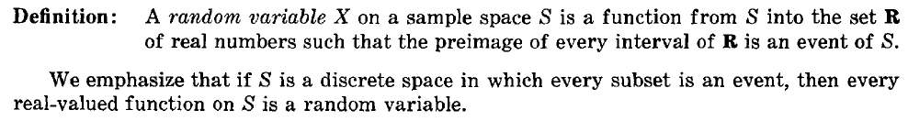

Slide 12
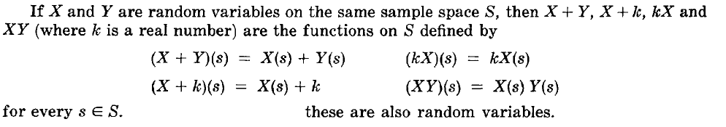

Slide 15
Probability Distributions for Discrete Random Variables
The probability distribution of a discrete random variable is a graph, table or formula that specifies the probability associated with each possible outcome the random variable can assume.
p(x) ≥ 0 for all values of x
Σp(x) = 1

Slide 16
Probability Distributions for Discrete Random Variables
x | P(x)
1 | .30
2 | .21
3 | .15
4 | .11
5 | .07
6 | .05
7 | .04
8 | .02
9 | .02
10 | .01
Say a random variable x follows this pattern: p(x) = (.3)(.7)^{x-1}
for x > 0.
This table gives the probabilities (rounded to two digits) for x between 1 and 10.

Slide 17
Probability functions
A probability function maps the possible values of x against their respective probabilities of occurrence, p(x)
p(x) is a number from 0 to 1.0.
The area under a probability function is always 1.
Notes:
It turns out that if you were to go out and sample many, many times, most sample statistics that you could calculate would follow a normal distribution.
What are the 2 parameters (from last time) that define any normal distribution?
Remember that a normal curve is characterized by two parameters, a mean and a variability (SD)
What do you think the mean value of a sample statistic would be? The standard deviation?
Remember standard deviation is natural variability of the population
Standard error can be standard error of the mean or standard error of the odds ratio or standard error of the difference of 2 means, etc. The standard error of any sample statistic.

Slide 18
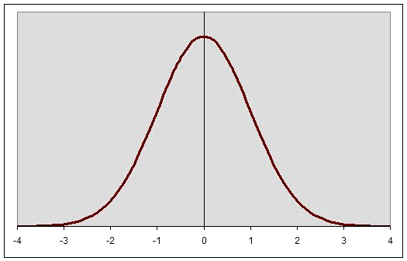

Slide 19
Discrete example: roll of a die
p(x)
1/6
x
1
2
3
4
5
6

Slide 25
Expected Value and Variance
All probability distributions are characterized by an expected value (mean) and a variance (standard deviation squared).

Slide 26
Expected value of a random variable
Expected value is just the average or mean (µ) of random variable x.
It’s sometimes called a “weighted average” because more frequent values of X are weighted more highly in the average.
It’s also how we expect X to behave on-average over the long run (“frequentist” view again).

Slide 27
Expected value, formally
Discrete case:
Continuous case:

Slide 28
Symbol Interlude
E(X) = µ
these symbols are used interchangeably

Slide 29
Another Random variable for the same example

Slide 33
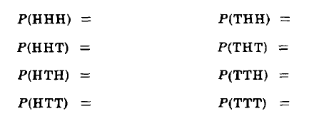

Slide 35
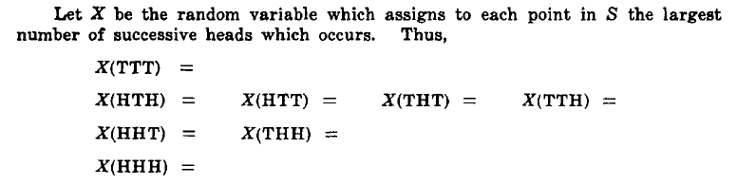

Slide 37
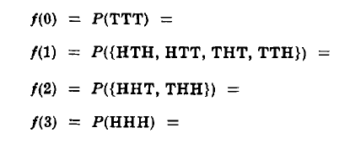

Slide 41
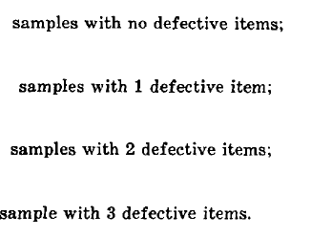

Slide 45
A school class of 120 students is driven in 3 buses to a symphonic performance. There are 36 students in one of the buses, 40 in another, and 44 in the third bus. When the buses arrive, one of the 120 students is randomly chosen. Let X denote the number of students on the bus of that randomly chosen student, and find E[X].

Slide 47
However, the average number of students on a bus is 120/3 = 40, showing that the expected number of students on the bus of a randomly chosen student is larger than the average number of students on a bus. This is a general phenomenon, and it occurs
because the more students there are on a bus, the more likely it is that a randomly
chosen student would have been on that bus. As a result, buses with many students
are given more weight than those with fewer students.

Slide 48
Two marbles are chosen randomly from an urn containing
8 white, 4 black, and 2 orange marbles. Suppose
that we win $2 for each black marble selected
and we lose $1 for each white marble selected. Let
X denote our winnings. What are the possible values
of X, and what are the probabilities associated
with each value?

Slide 49
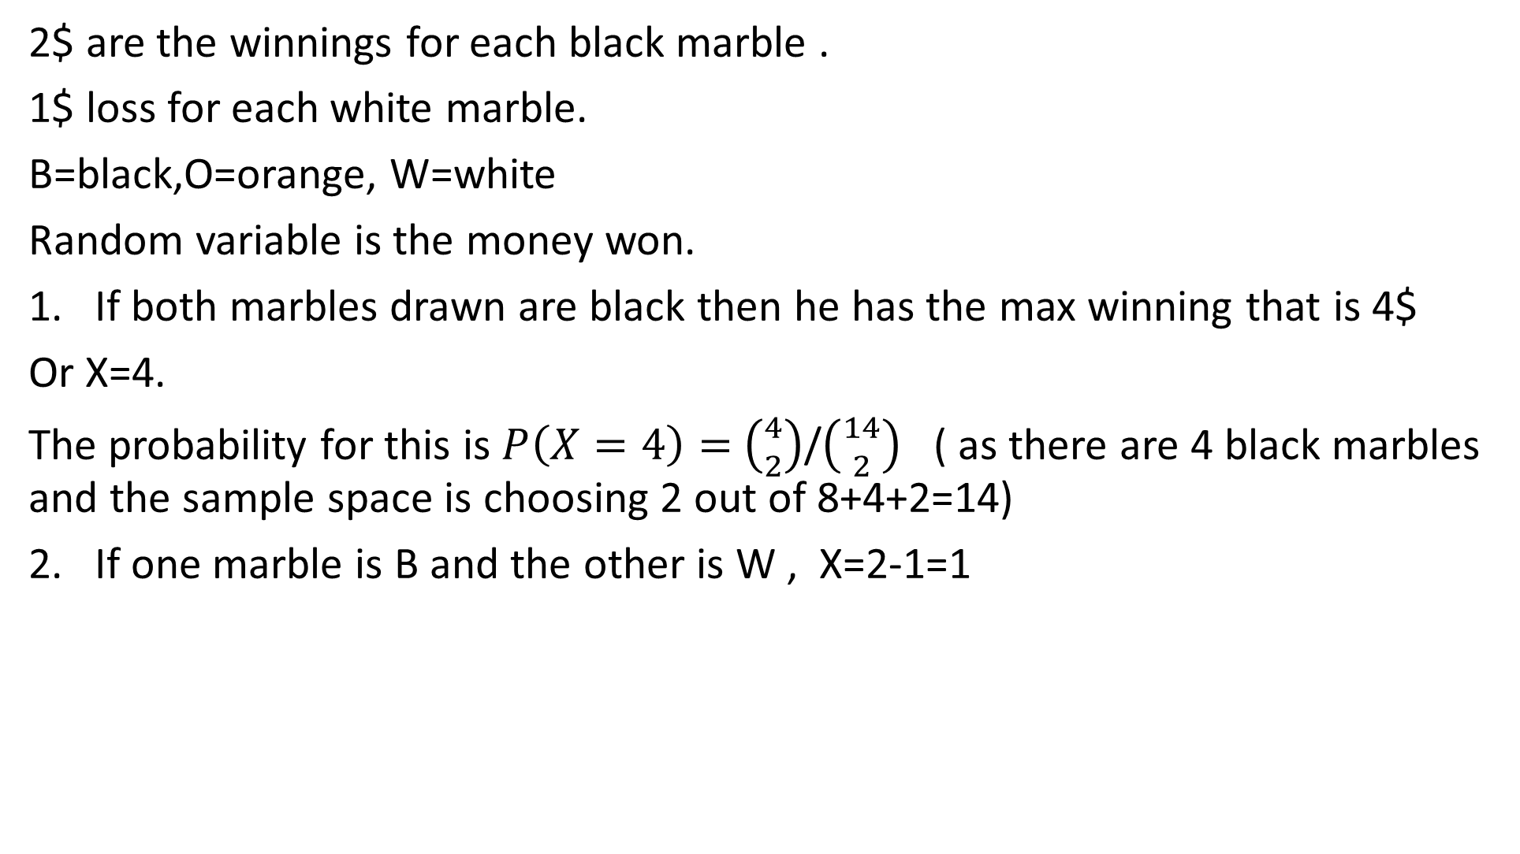
2$ are the winnings for each black marble .
1$ loss for each white marble.
B=black,O=orange, W=white
Random variable is the money won.
If both marbles drawn are black then he has the max winning that is 4$
Or X=4.
The probability for this is $P\left(X=4\right)=$ $\left({4 \atop 2}\right)$/$\left({14 \atop 2}\right)$ ( as there are 4 black marbles and the sample space is choosing 2 out of 8+4+2=14)
If one marble is B and the other is W , X=2-1=1

Slide 50
If X=2 It is 1 B and 1 orange
If X= 0 it is 2 orange
If X=-1 it is 1 W and 1 orange
If X=-2 it is 2 W

Slide 51
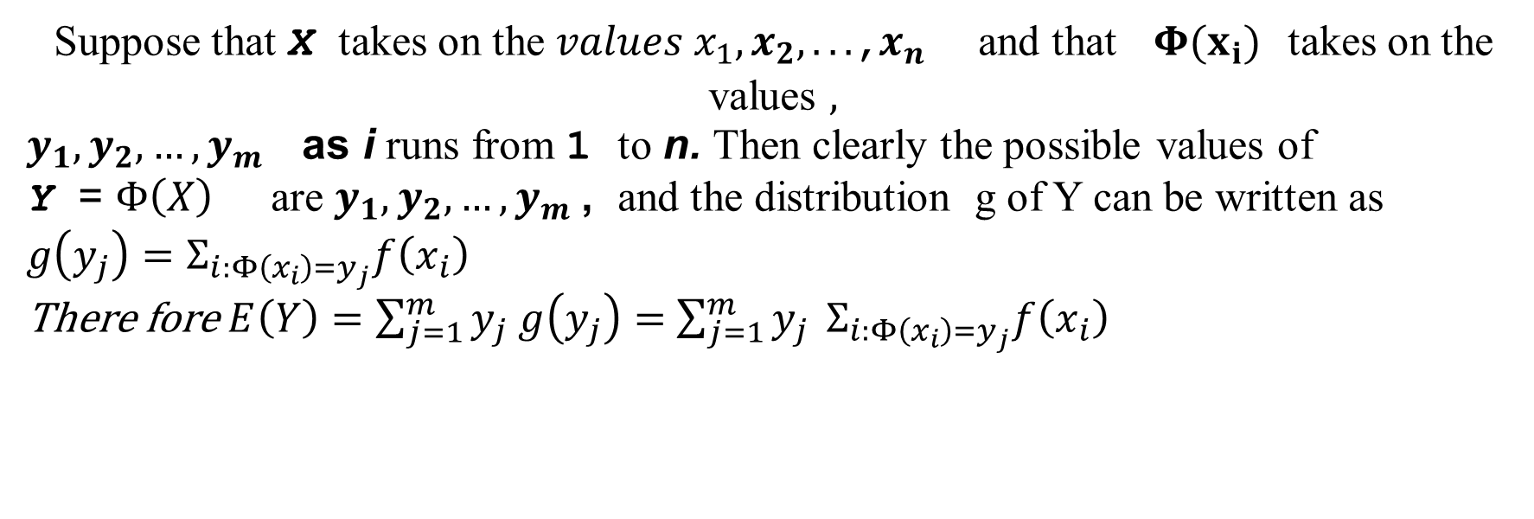
Suppose that X takes on the $values x_{1},x_{2},.. .$,$x_{n}$ and that $Φ(x_{i})$ takes on the values $,$
$y_{1},y_{2},…,y_{m}$as i runs from 1 to n. Then clearly the possible values of
Y = $Φ\left(X\right)$are $y_{1},y_{2},…,y_{m}$, and the distribution g of Y can be written as
$g\left(y_{j}\right)=Σ_{i:Φ\left(x_{i}\right)=y_{j}}f\left(x_{i}\right)$
There fore $E\left(Y\right)=\sum_{j=1}^{m}{y_{j} g\left(y_{j}\right)=}$ ${\sum_{j=1}^{m}{y_{j} }Σ}_{i:Φ\left(x_{i}\right)=y_{j}}f\left(x_{i}\right)$

Slide 53
Each of the random variables which arise from the function $Φ\left(X\right)$are from the same sample space as X
So they have the probability of each $x_{i}$

Slide 54
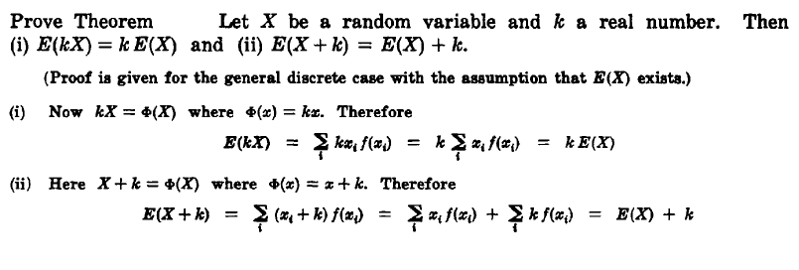

Slide 55
Variance/standard deviation
σ²=Var(x) =E(x-μ)²
“The expected (or average) squared distance (or deviation) from the mean”

Slide 56
Variance, continuous
Discrete case:
Continuous case?:

Slide 57
Symbol Interlude
Var(X)= σ²
SD(X) = σ
these symbols are used interchangeably

Slide 58
Similarity to empirical variance
The variance of a sample: s² =
Division by n-1 reflects the fact that we have lost a “degree of freedom” (piece of information) because we had to estimate the sample mean before we could estimate the sample variance.

Slide 59

Let X be a Random Variable then its
Is given by
Where =

Slide 61
Find the mean, variance and the standard deviation of this distribution

Slide 63
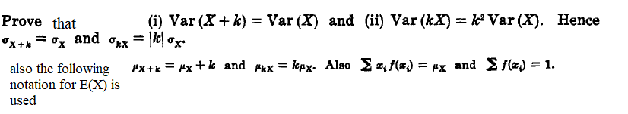

Slide 64

V$AR(X+k)$= $Σ{\left(x_{i}+k\right)}^{2}f\left(x_{i}\right)−\left(Σ{(x}_{i}+k\right)f(x_{i}))$²

Slide 66
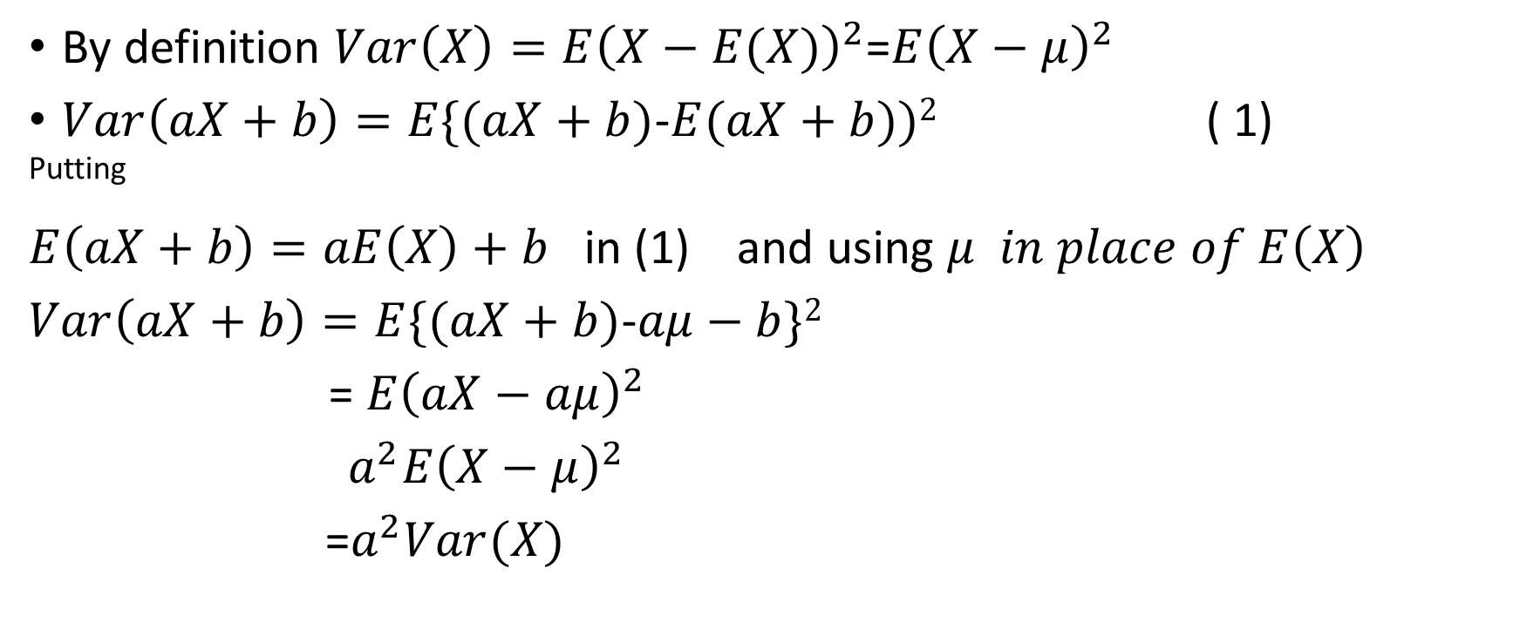
By definition $Var\left(X\right)=E{\left(X−E(X)\right)}^{2}$=$E{\left(X−μ\right)}^{2}$
$Var\left(aX+b\right)=E\{(aX+b)$-$E(aX+b))2$ ( 1)
^{Putting}
$E\left(aX+b\right)=aE\left(X\right)+b$ in (1) and using $μ in place of E\left(X\right)$
$Var\left(aX+b\right)=E\{(aX+b)$-$aμ−b\}2$
= $E{\left(aX−aμ\right)}^{2}$
$a^{2}E{\left(X−μ\right)}^{2}$
=$a^{2}Var(X)$

Slide 67
alternatively

Slide 72


Slide 73
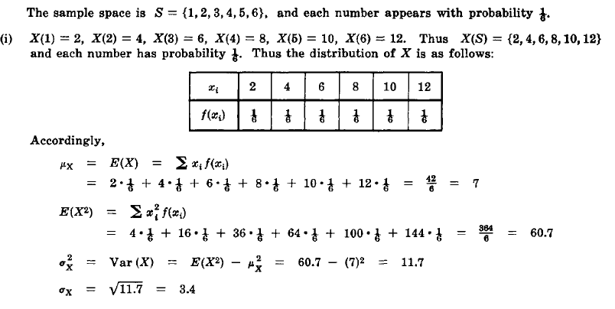

Slide 77
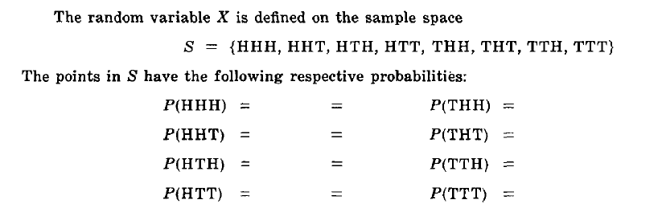

Slide 83
To determine whether they have a certain disease, 100 people are to have their blood tested. However, rather than testing each individual separately, it has been decided first to place the people into groups of 10. The blood samples of the 10 people in each group will be pooled and analysed together. If the test is negative, one test will suffice for the 10 people, whereas if the test is positive, each of the 10 people will also be individually tested and, in all, 11 tests will be made on this group. Assume that the probability that a person has the disease is .1 for all people, independently of each other, and compute the expected number of tests necessary for each group. (Note that we are
assuming that the pooled test will be positive if at least one person in the pool has the disease.)

Slide 84
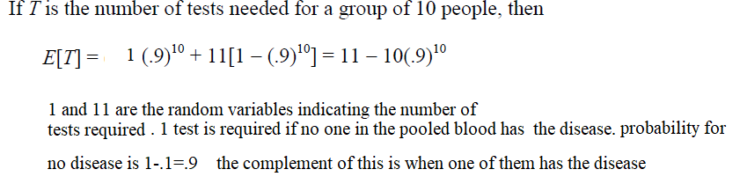

Slide 85
A box contains 5 red and 5 blue marbles. Two marbles are withdrawn randomly.
If they are the same color, then you win $1.10;
if they are different colors, then you win −$1.00. (That is, you lose $1.00.)
Calculate
(a) the expected value of the amount you win;
(b) the variance of the amount you win.

Slide 86
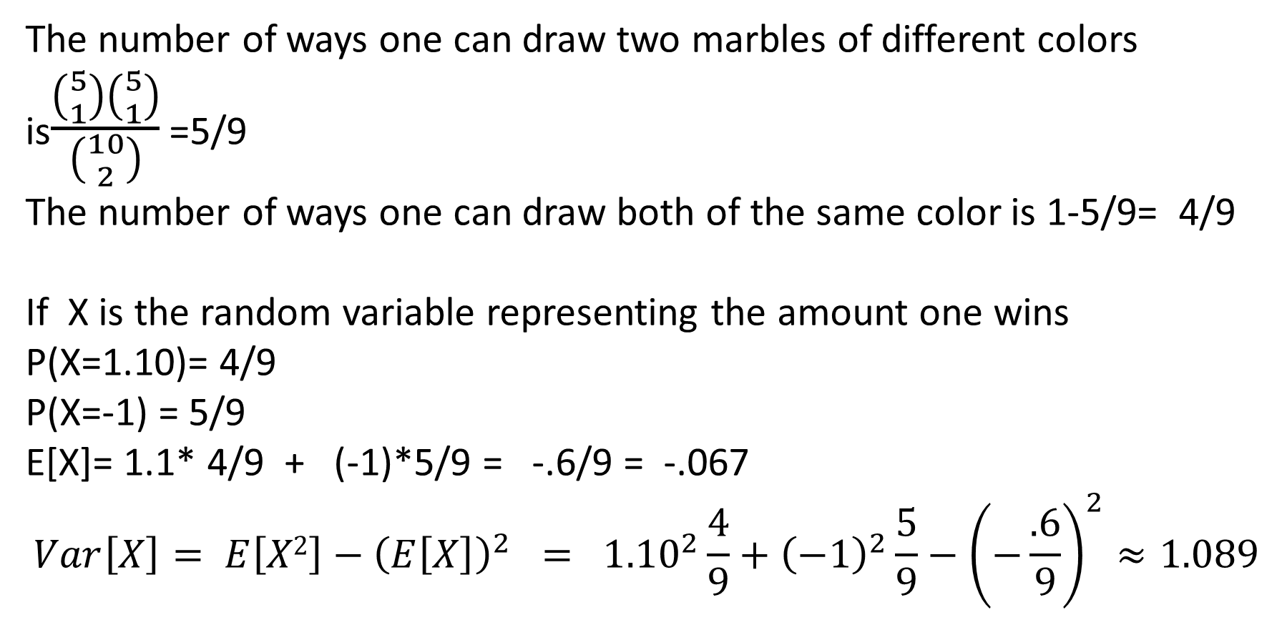
The number of ways one can draw two marbles of different colors is$\frac{\left({5 \atop 1}\right)\left({5 \atop 1}\right)}{\left({10 \atop 2}\right)}$ =5/9
The number of ways one can draw both of the same color is 1-5/9= 4/9
If X is the random variable representing the amount one wins
P(X=1.10)= 4/9
P(X=-1) = 5/9
E[X]= 1.1* 4/9 + (-1)*5/9 = -.6/9 = -.067
$$Var\left[X\right]= E\left[X2\right]−{\left(E\left[X\right]\right)}^{2} = {1.10}^{2}\frac{4}{9}+{\left(−1\right)}^{2}\frac{5}{9}−{\left(−\frac{.6}{9}\right)}^{2}≈1.089$$

Slide 87
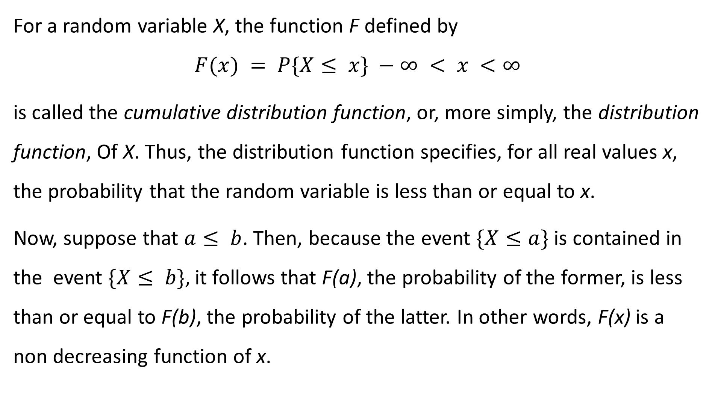
For a random variable X, the function F defined by
$$F(x) = P\{X≤ x\} −∞ < x <∞$$
is called the cumulative distribution function, or, more simply, the distribution function, Of X. Thus, the distribution function specifies, for all real values x, the probability that the random variable is less than or equal to x.
Now, suppose that $a≤ b$. Then, because the event $\{X≤a\}$is contained in the event $\{X≤ b\},$it follows that F(a), the probability of the former, is less than or equal to F(b), the probability of the latter. In other words, F(x) is a non decreasing function of x.

Slide 90
0 since the probability is not given
¼ since it is added upto 1
P(1)+P(2)=1/4 +1/2=3/4
P(1)+P(2)+P(3)= 1/4 +1/2+1/8= 7/8
P(1)+P(2)+P(3)+P(4)= 1/4 +1/2+1/8+1/8=1

Slide 94
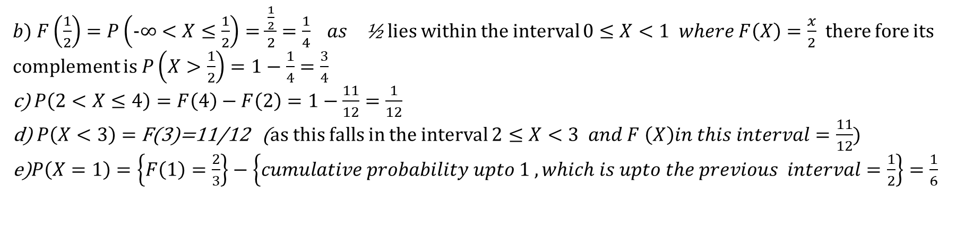
$b) F\left(\frac{1}{2}\right)=P\left(−∞<X≤\frac{1}{2}\right)=\frac{\frac{1}{2}}{2}=\frac{1}{4} as$ ½ lies within the interval $0≤X<1 where F\left(X\right)=\frac{x}{2}$ there fore its complement is $P\left(X>\frac{1}{2}\right)=1−\frac{1}{4}=\frac{3}{4}$
c) $P\left(2<X≤4\right)=F\left(4\right)−F\left(2\right)=1−\frac{11}{12}=\frac{1}{12}$
d) $P\left(X<3\right)=$ F(3)=11/12 (as this falls in the interval $2≤X<3 and F \left(X\right)in this interval=\frac{11}{12})$
e)$P\left(X=1\right)=\left\{F\left(1\right)=\frac{2}{3}\right\}−\left\{cumulative probability upto 1 , which is upto the previous interval=\frac{1}{2}\right\}=\frac{1}{6}$

Slide 96
A secretary has typed N letters along with their respective envelopes. The envelopes get mixed up when they fall on the floor. If the letters are placed in the mixed-up
envelopes in a completely random manner (that is, each letter is equally likely to end up in any of the envelopes), what is the expected number of letters that are placed in the
correct envelopes?

Slide 97

Letting X denote the number of letters that are placed in the correct envelope,
$X =X_{1} + X_{2} +・ ・ ・+X_{N}$

Slide 98
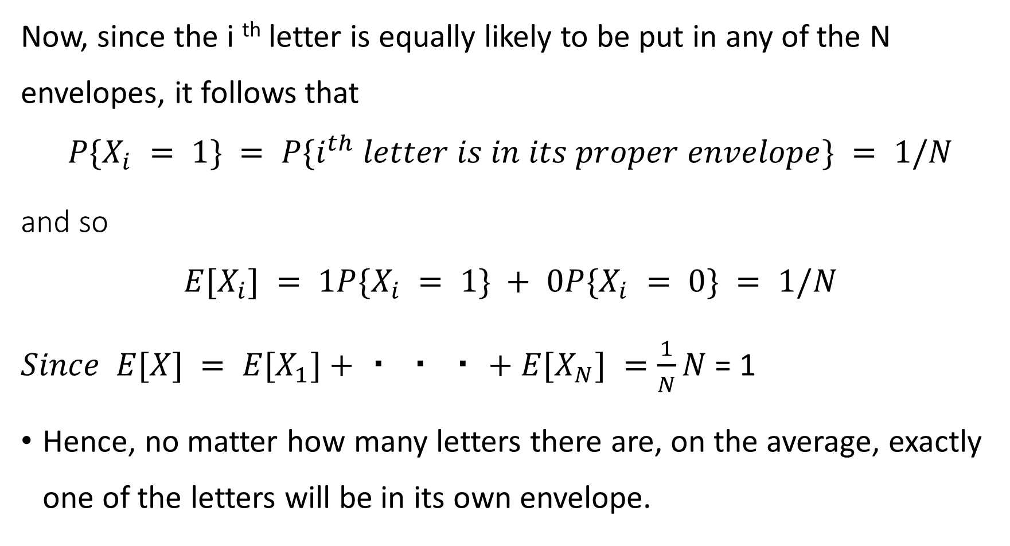
Now, since the i ^{th} letter is equally likely to be put in any of the N envelopes, it follows that
$$P\{X_{i} = 1\} = P\{i^{th} letter is in its proper envelope\} = 1/N$$
and so
$$E[X_{i}] = 1P\{X_{i} = 1\} + 0P\{X_{i} = 0\} = 1/N$$
$Since E[X] = E[X_{1}]+・ ・ ・+E[X_{N}] =\frac{1}{N}N$ = 1
Hence, no matter how many letters there are, on the average, exactly one of the letters will be in its own envelope.

Slide 105
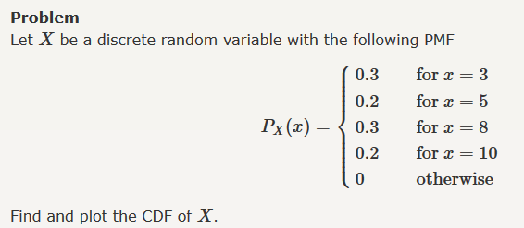

Slide 106
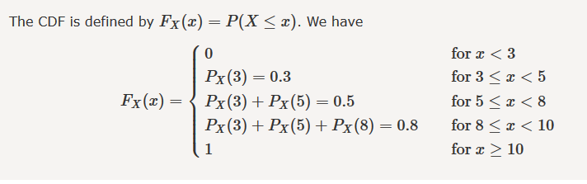

Slide 108

P(0)=$P(X≤0$)-$P\left(X<0\right)=\frac{1}{2}−0=\frac{1}{2}$
$\text{P}\text{(1)}\text{=}P(X≤\text{1}\text{)-}P\left(X<1\right)=\frac{3}{5}−\frac{1}{2}=\frac{1}{10}$
P(2)=$P(X≤2$)-$P\left(X<2\right)=\frac{4}{5}−\frac{3}{5}=\frac{1}{5}$
P(3)=$P(X≤3$)-$P\left(X<3\right)$=$\frac{9}{10}−\frac{4}{5}=\frac{1}{10}$
P(3.5)=$P(X≤3.5$)-$P\left(X<3.5\right)=1−\frac{9}{10}=\frac{1}{10}$

